Slide 1


Sample Guys
Data Analytics with Spotify
By:
Aditya Bhatnagar
Amisha Patel
Andrew C Stoops
Sean Wayland

Slide 2
What drives the Sample Guys?
DATA SCIENCE
01
MUSIC
02
Notes:
Talk about the why we wanted to do this as a project, and a bit to connect our backgrounds and passion in music!

Slide 3
Goal
What song attributes make it a hit?
Use Spotify’s API to extract, analyze and understand music from a mathematical standpoint.
How song attributes have changed over time?
Are attributes of a song correlated with each other as well as economic factors like unemployment?
Understand trends in ‘hit’ songs based on data extracted from Spotify’s API
How different is a ‘hit song’ from a ‘random song’?

Slide 4
Data Sources
Spotify provides a robust collection of songs across various genres and heavily utilizes analytics to provide its users with a personalized music experience.
We used Spotify’s API to extract all the songs in top 100 billboard playlists from years 1975-84 and 2000-2009.
Used Bureau of Labor Standards (BLS) for unemployment data from 1975-84 and 2000-2009.

Slide 5
Exploring Data
Challenges:
Spotify’s token system
Size of data
Maintaining Data
Statistical Significance of Data (paired T-test)
Defining and Extracting ‘Random’ song
Time constraint

Slide 6
Definitions
Song Characteristic | Description
Danceability | Danceability describes how suitable a track is for dancing based on a combination of musical elements including tempo, rhythm, stability, beat strength, and overall regularity.
Acousticness | Music that solely or primarily uses instruments that produce sound through acoustic means, as opposed to electric or electronic means.
Loudness | Loudness is the quality of a sound that is the primary psychological correlate of physical strength (amplitude)
Liveness | Detects the presence of an audience in the recording.
Energy | Represents a perceptual measure of intensity and activity. Perceptual features contributing to this attribute include dynamic range, perceived loudness, timbre, onset rate, and general entropy.
Valence | The musical positiveness conveyed by a track. Tracks with high valence sound more positive (e.g. happy, cheerful, euphoric), while tracks with low valence sound more negative (e.g. sad, depressed, angry)
Tempo | Tempo is the speed or pace of a given piece and derives directly from the average beat duration

Slide 7
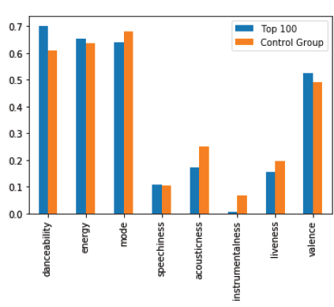
Analysis

Slide 8
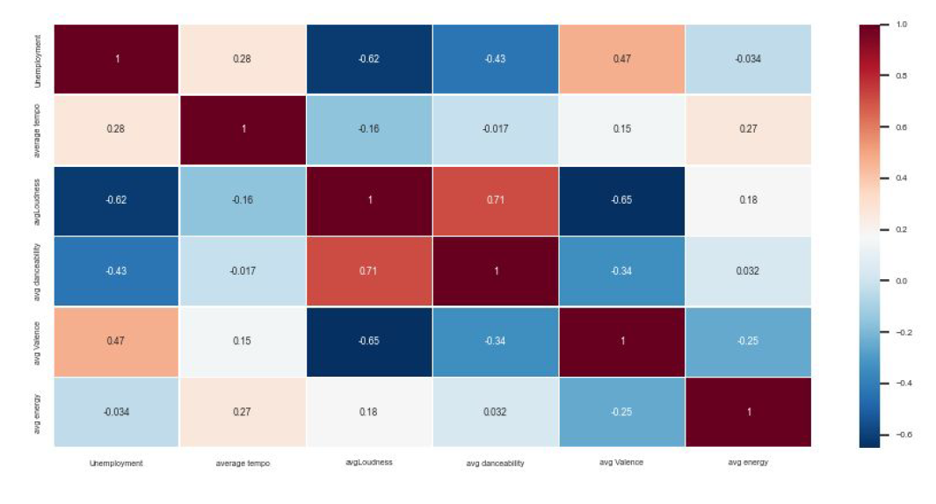
Analysis

Slide 9
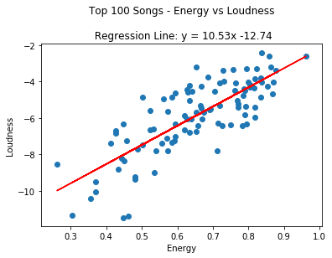
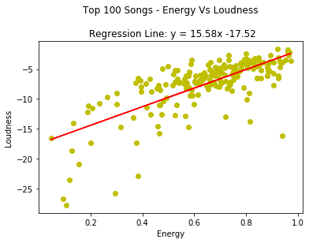
Analysis

Slide 10
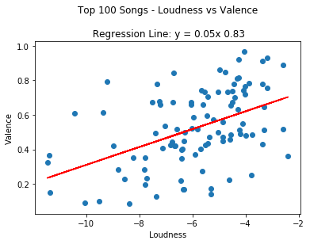
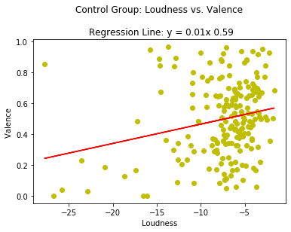
Analysis

Slide 11
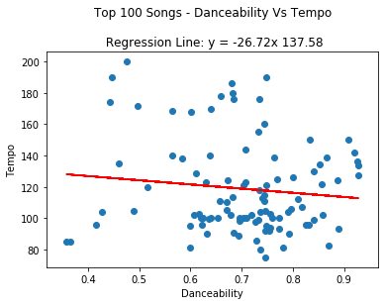
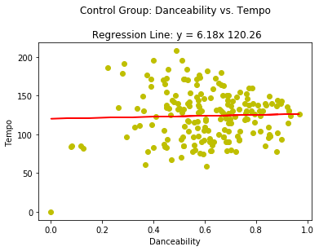
Analysis

Slide 12
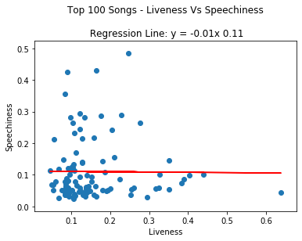
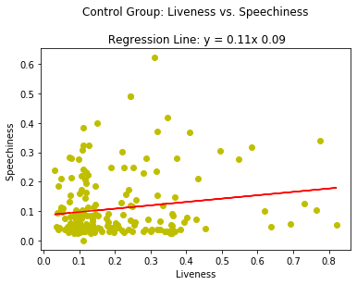
Analysis

Slide 13
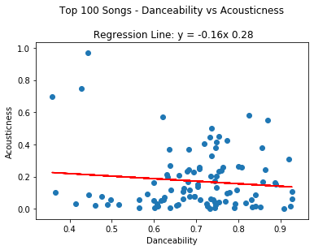
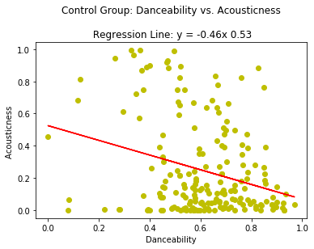
Analysis

Slide 14
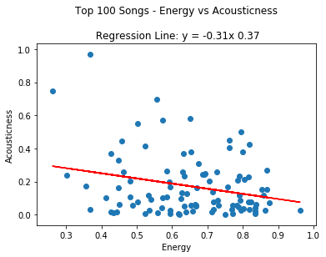
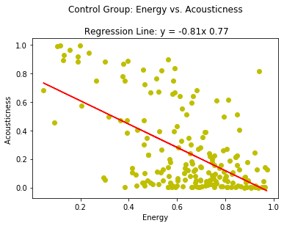
Analysis

Slide 15
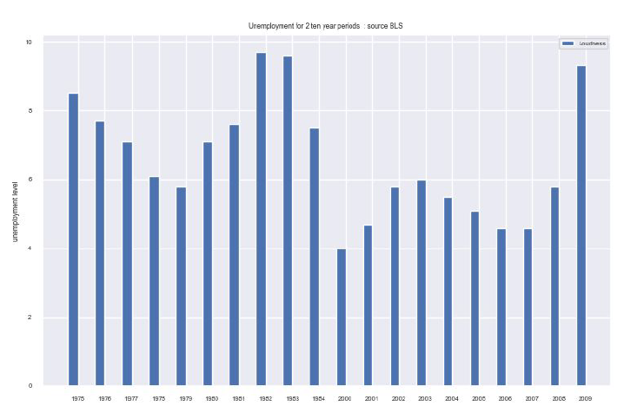
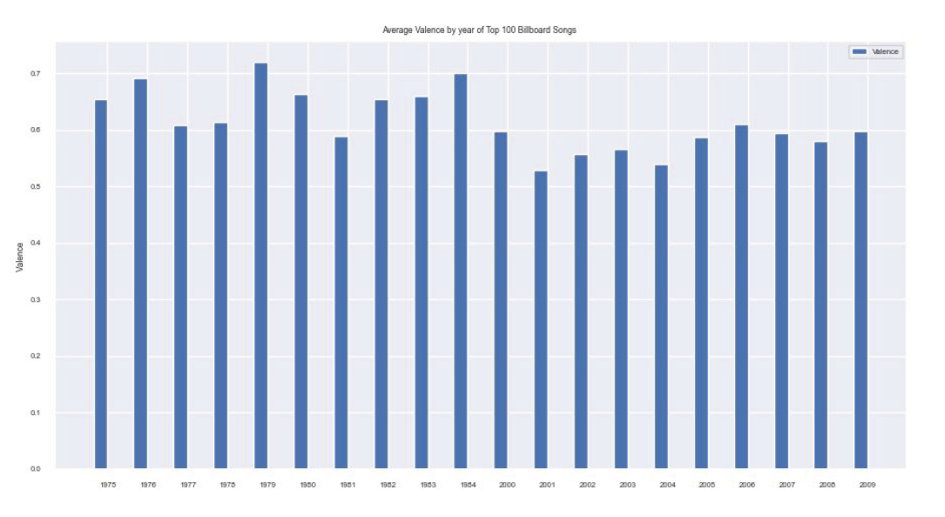
Analysis

Slide 16
Summary
Most song attributes are consistent across the years.
The null hypothesis stated that Top 100 neither
‘Loudness’ in overall music has increased manifolds over the years.
Song characteristics loosely defined by Spotify around machine learning algorithms.
There are factors that can not be quantified mathematically that govern a song’s overall success.
People are not predictable, statistical significance does always direct us towards causality.

